Slide 1


Suspicious Activity Recognition from
a Live Video
using
Deep Learning
Rishabh Kumar Panthri
Mohan Paliwal
Abhigyan Tomar
Ms. Nishu Gupta
Dr. Jitendra Kumar Seth
KIET Group Of Institutions, Ghaziabad

Slide 2
CONTENTS
1. Introduction
2. Limitations of Manual Surveillance
3. Automation as a Solution
4. Research Motivation
5. Problem Statement
6. Related Work
7. Proposed System
8. Architecture of Proposed System
9. Features Of Proposed System
10.Dataset and Experimental Setup
11.Results
12.Conclusion
13.Future Scope

Slide 3
INTRODUCTION
Imagine a person sitting in a control room, tasked with monitoring several surveillance cameras simultaneously, analyzing real-time activities, and identifying threats. This scenario is not only mentally exhausting but also prone to human error.

Slide 4
LIMITATIONS OF MANUAL SURVEILLANCE
Cognitive Overload: Human operators struggle to maintain focus over long periods, especially when handling multiple video feeds.
Delayed Response: Human interpretation of suspicious activities is slow, leading to potential delays in action.
Scalability Issues: Adding more cameras requires more operators, increasing cost and complexity.

Slide 5
AUTOMATION AS A SOLUTION
Real-time Threat Detection: Automating surveillance makes real-time threat detection feasible across multiple streams.
Consistency and Accuracy: Automation improves consistency and accuracy in threat detection, reducing false positives and missed detections.
Immediate Alerts: Automated systems generate immediate alerts, enabling quick responses to threats.

Slide 6
RESEARCH MOTIVATION
The need for intelligent surveillance systems has grown exponentially due to increasing deployment of security cameras, rising security concerns, and human limitations in monitoring multiple video feeds. This drives the need for systems capable of environment-dependent activity flagging and instant alert mechanisms.

Slide 7
PROBLEM STATEMENT
This research addresses key challenges such as real-time processing of video streams while maintaining high accuracy, effective integration of spatial and temporal information for precise activity recognition, and flexible adaptation to varying security requirements across different environments.

Slide 8
RELATED WORK
Several approaches have been proposed in the field of automated video surveillance and activity recognition, including traditional methods using hand-crafted features, CNN-based methods for spatial feature extraction, 3D CNNs and RNNs for temporal information, and two-stream networks integrating RGB and optical flow.

Slide 9
Traditional Methods: Use hand-crafted features (e.g., HOG, SIFT) and classical classifiers (SVMs, decision trees), which are often limited in capturing complex visual and motion patterns.
CNN-based Methods: Models like ResNet and VGGNet have shown strong results in spatial feature extraction but fall short in modeling temporal dynamics.
3D CNNs and RNNs: Used to handle temporal information, but often suffer from high computational costs and limited long-range dependency modeling.
Two-stream networks: Integrate RGB and optical flow, but are not ideal for real-time performance due to the heavy computation involved in flow estimation.

Slide 10
PROPOSED SYSTEM
The proposed system includes YOLOv8 for efficient real-time person detection, ResNet34 as a robust feature extractor for visual patterns, and a Transformer encoder to capture temporal dependencies and contextual relationships between frames.

Slide 11
ARCHITECTURE OF PROPOSED SYSTEM
The architecture of the proposed system involves several stages, starting from using the UCF101 Dataset, frame extraction, person detection using YOLOv8, preparing datasets for ResNet34 and Transformer, training the models, and evaluating the performance. The process includes features like person scoring, smart frame sampling, and strong regularization techniques.

Slide 12
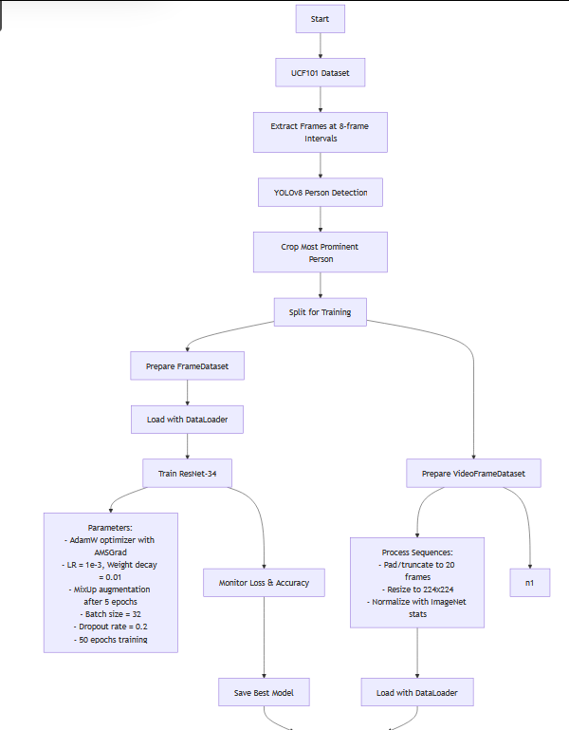
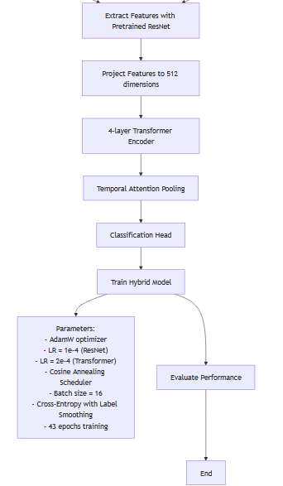

Slide 13
FEATURES OF
PROPOSED SYSTEM
Person Scoring & Selection
Filters out irrelevant people using bounding box score (centered, large).
Improves action focus and classification accuracy.
Smart Frame Sampling (Interval = 8)
Avoids redundancy, captures key motion.
Faster training, more temporal diversity.

Slide 14
ResNet + Transformer (vs. 3D-CNN or LSTM)
ResNet handles spatial info; Transformer models sequence.
Better generalization, simpler pipeline.art Frame Sampling (Interval = 8)
Strong Regularization
MixUp, label smoothing, dropout, grad clipping.
Less overfitting, smoother learning.
Learnable Attention Pooling
Learns which frames matter most.
More focused, robust predictions.
Solves Vanishing/Exploding Gradients
Transformers with residuals + normalization handle deep sequences.
Gradient clipping prevents instability during training.

Slide 15
DATASET AND EXPERIMENTAL SETUP
The dataset UCF101 was available on Kaggle
The experiment was conducted on Kaggle notebook with Nvidia Tesla P100 GPU
The major libraries used were
Ultralytics for Yolo
OpenCV for image extraction
Pytorch for transformer encoder and ResNet34.
PIL for image processing
tqdm for progress bars

Slide 16
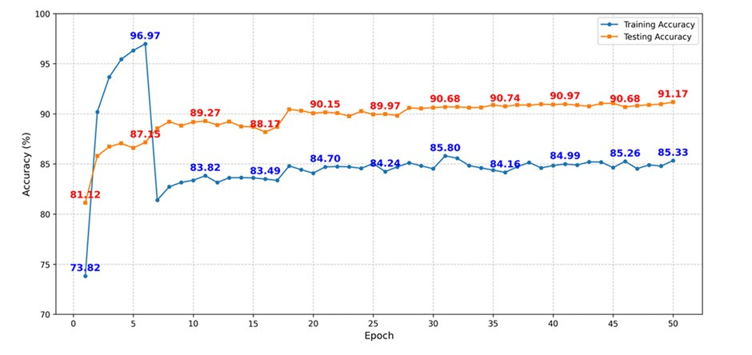
RESULTS
The standalone ResNet-34 model achieved 91.17% accuracy in frame classification. When considering averaging of frame-wise classification of a video, the accuracy was 82.96%.

Slide 17
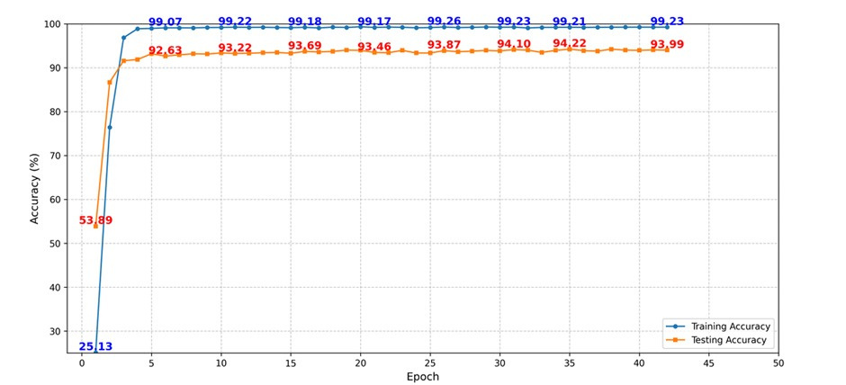
RESULTS
Integrating ResNet-34 with a Transformer encoder significantly improved performance, achieving an accuracy of 94.22%.

Slide 18
CONCLUSION
Hybrid Model Development: Developed a hybrid model combining ResNet34 and Transformer Encoder for suspicious activity detection.
Performance Improvement: Accuracy improved from 82.96% to 94.22%, and test loss reduced from 0.8344 to 0.4161.
Real-time Capabilities Included real-time capabilities with context-aware alarm triggers, mixed precision training, and dynamic learning rate scheduling.
Tackled key model issues: Vanishing/Exploding gradients handled with Batch Normalization and Gradient Clipping. Dual pooling and Transformer attention enhanced temporal and spatial feature extraction.

Slide 19
FUTURE SCOPE
Future work may involve incorporating multimodal data like audio and thermal imaging for better detection in diverse conditions, exploring advanced models such as next-gen YOLO versions and improved Residual Networks or Transformers, and investigating federated learning to enhance privacy while maintaining accuracy across distributed systems.

Slide 20
THANK
YOU

